Slide 1
Advanced Revision Control with GIT
Notes:
https://github.com/blog/2019-how-to-undo-almost-anything-with-git

Slide 2
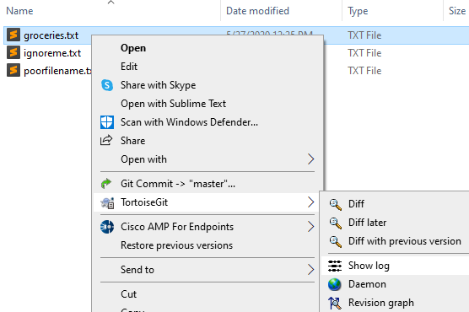
File specific history / Blame
When looking at the log for a single file, Tortoise will only show commits relevant to that one file.
Notes:
This is useful for larger projects to help narrow in on specific changes.

Slide 3
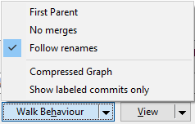
Rename / Move file
When you rename or move files, you disconnect their history.
To view the disconnected history in Tortoise you can use the follow renames checkbox.
Notes:
Git will show a new file being added to the repository and the other one being deleted the next time you commit.
Then, if you look at the log for the new file, it will have almost no history.

Slide 4
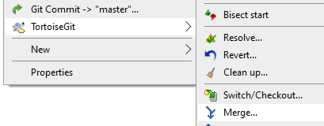
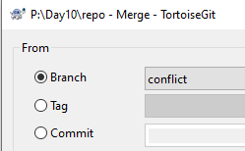
Merge
To merge you first need to switch to the branch you want to merge into.
Then using the merge command you can apply a change set by key or branch.
Notes:
Blame – Identify who last changed each line in a file

Slide 5

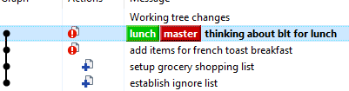
Merge - Fast-Forward
Every commit in the destination branch is already contained in the source branch.
Because there is no possible conflict, git will simply move the label.
Notes:
This is when you can establish a direct line between the commit and the original parent during a merge.

Slide 6

Conflicts
When GIT is unable to merge your data automatically, because of overlapping history or other reasons
(e.g., Binary files)
You must resolve your local copy
Usually by editing the files in conflict, then marking them as resolved
Notes:
For further details see Tortoise Help (3.24. Resolving Conflicts)
Most repositories are used via http://
If you are using file:// with multiple users on a network share, you can run into problems when 2+ users try to lock the same file for changes.
This will leave files in a conflicted state.

Slide 7

Stash
Git allows you to take the info in the index and push it onto a stack for later use.
When you do this, its like a temporary revert, because it wipes the index.
Notes:
Git allows you to take the information in the index and push it onto a stack.
When you do this it will revert your working copy back to the last commit.
A pop (aka apply) will insert the data back into the WC.
http://git-scm.com/book/en/v1/Git-Tools-Stashing
git stash save “particle thingy”
<Edit AiBot.cpp>
git commit –m “changed AI bot pathing to turn left”
git stash pop
Also: To learn why I have a funny mustache on my face … http://www.movember.com

Slide 8
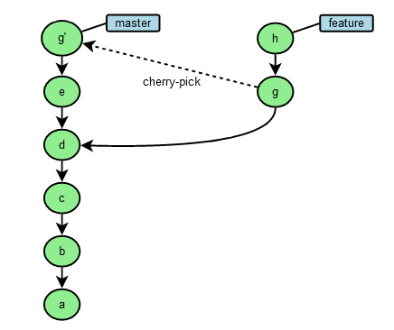
Cherry Pick
Copy
a particular commit from one branch to another. (Partial-Merge)
Notes:
Within Tortoise this can be done from within the log.
Right click on a particular commit and “cherry pick this commit.”
Image taken from:
http://illustrated-git.readthedocs.org/en/latest/index.html

Slide 9
Reset
*WARNING* This can destroy your repository!
Never do this with branches you have pulled or pushed!
Notes:
Since a reset effectively wipes out whole commits, if you have pushed or pulled those commits the remote server will get confused when it comes to the hierarchy of nodes.
This is also true when using the –amend version of commit, which recreates the latest commit node.

Slide 10
Reset (Move the pointer)
Soft
Leave index untouched (for small changes)
Mixed
Reset index (useful when files are removed)
Hard
Reset index
Purge changes
Notes:
All modes move the branch pointer.
There is still a way to go back even after resetting, by using the reflog command on the command line.
See this video for a good example of that: https://www.youtube.com/watch?feature=player_detailpage&v=W39CfI3-JFc#t=2657

Slide 11
Rebase
*WARNING* This can destroy your repository!
*NEVER* do this with branches you have pulled or pushed!
Notes:
Since rebasing re-writes your history, if a remote computer already knows of those new pieces, pushing them up as part of a different branch will get everything out of sync.

Slide 12
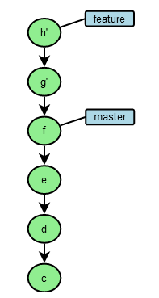
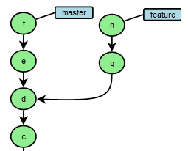
Rebase
This moves a fork in your branch hierarchy.
Notes:
Image taken from: http://illustrated-git.readthedocs.org/en/latest/index.html
It does not change the parent branch in any way. Only the parent of the feature branch gets moved.
We do this to make merging our branch easier on the maintainer. (It will be a fast-forward at that point.)
In the tortoise dialog: upstream refers to the base (B) and the branch (C) is the thing you are tacking onto the end of the upstream.
A – B – C
If you reverse them it becomes
A – C – B

Slide 13
Rebase
Rebase is NOT a merge.
So why do it?
Notes:
A typical workflow involving rebasing is as follows:
git checkout new-feature
… work …
git commit –m changes
git pull <from origin>
git rebase master <this will rebase your feature branch on any new changes others have pushed to the origin/master branch>
… resolve conflicts …
git checkout master
git merge new-feature <fast forward>
git push
See also: http://git-scm.com/book/ch3-6.html

Slide 14
Fetch / Pull
Fetch is like a Pull but without a Merge.
Notes:
Be careful when pulling from a non-track-linked location because you auto-merge to the current branch, even if it’s a different branch.
Graphic image taken from
https://stackoverflow.com/questions/292357/what-is-the-difference-between-git-pull-and-git-fetch
See also
http://git-scm.com/book/en/Git-Branching-Remote-Branches
http://illustrated-git.readthedocs.org/en/latest/index.html
https://longair.net/blog/2009/04/16/git-fetch-and-merge/

Slide 15
Fetch/Rebase
Why would you do this for a single branch?
What would be the result?

Slide 16
Now you try it!
https://classroom.github.com/g/nJAMYh-p
Notes:
http://stackoverflow.com/questions/5343068/is-there-a-way-to-skip-password-typing-when-using-https-github
Put this in your %Home%/_netrc
machine edo.fullsail.com login luggage password 12345

